Slide 1
Student Performance Based on Various Attributes DONE BY:RAKESH

Slide 2
AGENDA
Topic one - Objective
Topic two – Data Set
Topic three – Pivot Table
Topic four – Dash Board
Topic five - Conclusion

Slide 3
OBJECTIVE
To analyze and visualize student academic performance using Pivot Tables and an interactive dashboard in Excel.

Slide 4
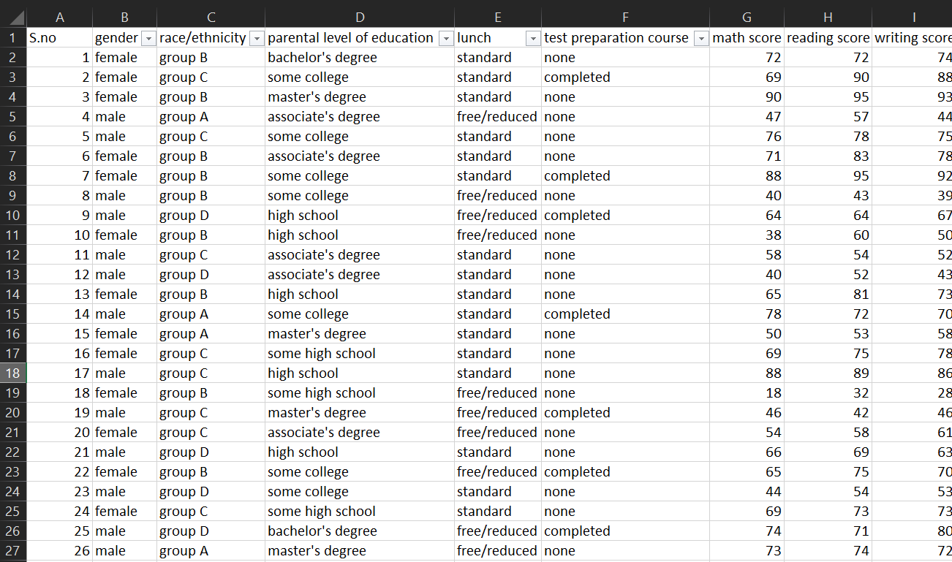

Slide 5
Overview
Overall Performance Summary
Gender-Based Performance
Effect of Test Preparation
Influence of Parental Education
Lunch Type Impact
Ethnicity-Based Trends

Slide 6
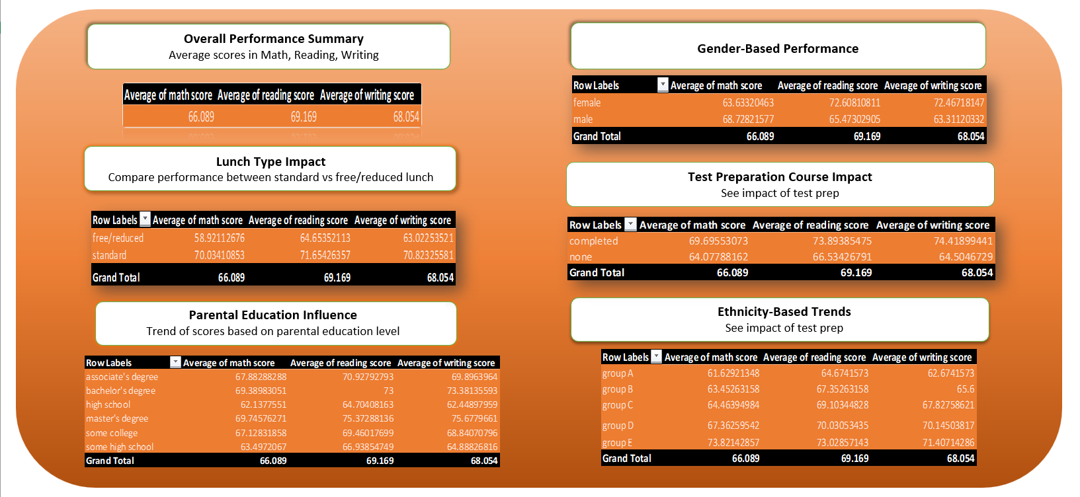

Slide 7
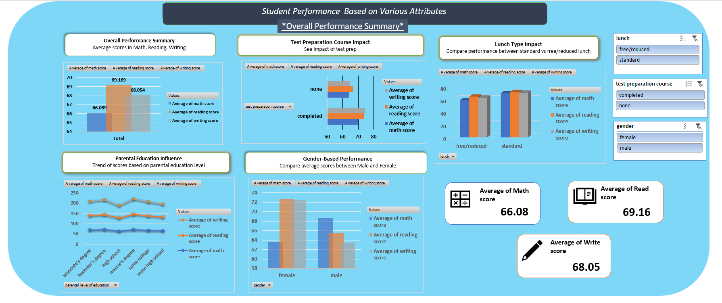

Slide 8
CONCLUSIONS
The dashboard reveals several key performance drivers:
Test preparation, lunch type, and parental education level are strong influencers of student success.
Females outperform males in literacy-based subjects, while males do better in math.
Students from higher social economic backgrounds (standard lunch, educated parents) score better across the board.
Ethnicity groups show varied performance trends, with Group E leading in all areas.

Slide 9
THANK YOU

